Slide 1
DiagnoGenie
Your Diagnostics Laboratory Manager
Work In Progress Report - Mar 21, 2023

Slide 2
Problem Statement
Managing a laboratory involves a lot of tasks such as tracking inventory, scheduling tests, managing lab equipment, and ensuring compliance with safety regulations. This can be a time-consuming and complex process. Inefficient management of a laboratory can lead to wasted resources, inaccurate results, and potential safety risks.
To overcome these challenges, there is a need for a laboratory manager software that can streamline the management of laboratory operations, increase efficiency, and ensure accurate and timely test results.
The key features of DiagnoGenie include inventory management, scheduling and tracking of tests, management of lab equipment, user access controls and permissions, and reporting and analytics for quality control and process improvement. It allows the end users to manage everything electronically, view tasks, and take control of them without having to search for the paperwork again in various protocols and file formats.

Slide 3
How does a current system work?
Operated manually and includes a lot of paperwork
Every appointment is made through a walk-in, a phone call
The lab assistant collects the sample and labels it with the customer's name
The lab technicians test these samples
After the sample has been examined, reports are either printed or sent via email
Reports from the imaging department must be carried physically
All of the inventory is currently tracked manually, and there is no report available on how things are going
Common issues faced with the system?
involves a lot of paperwork
physically storing reports creates a lot of tedious tasks and takes up a lot of space
manually sending reports over email
no proper communication
schedule the appointments
running out of inventory
compliance with security and privacy regulations

Slide 4
Functional Requirements
Who are the different stakeholders in the system?
Different stakeholders in this system will include laboratory technicians, lab assistants, doctors, patients, receptionist and supervisors.
What are the requirements for Patient?
Patients need access to their test results and the ability to request appointments and view their medical history.
What are the requirements for receptionist?
Receptionist need a system that can manage appointments, handle bill payments and generating invoices.
What are the requirements for lab assistant?
Lab Assistant need to get the details of the patients who booked the test and need a sample to be collected.
What are the requirements for lab technician?
Laboratory technicians need a user-friendly interface to perform tests, manage test results, and generate reports.
What are the requirements for doctor?
Doctors need access to test results in real-time and the ability to view patient reports.
What are the requirements for supervisor?
Supervisor needs to be able to look after the inventory, and generate reports and statistics .
Who will be able to schedule the appointment?
Patients/Customers, Receptionist and via some third party booking platform

Slide 5
Functional Requirements
How to confirm the booking availability of the test?
Need to check the Inventory for required equipment before scheduling the test.
How the payments need to managed?
A merchant account is to be created and linked with the card swiping machine and to pay online for online booking.
How the payment confirmation is sent?
The payment confirmation need to be sent through register email and phone number.
How to confirm booking of the test?
The booking confirmation and invoice should be sent through email and mobile number and if required invoice need to be printed.
Who will have access to the Inventory manager?
The Supervisor with access to edit the data will only have access to the data.
What kind of patient data does the Lab assistant require for collecting the sample?
The lab assistant will have the contact information and booking details of the customer.
How are the test samples collected and managed?
They can be collected at the diagnostic laboratory or in-home collection by the lab assistant and there should be a way to link the patient data with the sample.
How should the lab assistant update the collection details?
Using a mobile or tab or laptop, the lab assistant should update the status.

Slide 6
Functional Requirements
What updates are provided to the patient after the collection of the sample by the Lab assistant?
The status of the test like sample is collected is to be notified to the patient.
How will the lab technician access the samples collected by the lab assistant?
The samples collected by the lab assistant are placed for processing of the samples.
How will the lab technician access the system?
Lab technician should be able to access through the browser.
How the lab technician obtain the test results?
It depends on the type of the test performed. Some test results are obtained manually and some are obtained from the automated machinery.
How many categories of tests are available?
Hematology, Microbiology, Cardiography, Pathology, Radiology and Imaging are different categories and each category will have different tests.
What kind of data transformations are required?
Test reports will be in different formats, and we may need to convert to images and pdfs as required.
How the results are linked by the lab assistant with the sample collected?
The sample should have linked labels of patient data and this can be fetched while generating the report.
How the results from the machinery in the lab are accessed ?
The results are sent to the Diagnostic Machinery Computer Workstations and are accessed from there. Some tests that have manual process should be updated manually.
Who will have the access to the reports?
The patient and doctor will have the access to view the report.

Slide 7
Functional Requirements
How the reports are sent to patient?
The reports should be able to access in the browser or mobile phone and should be able to send this over email.
How does doctor interact with system and view the reports?
The system should be designed in a way to login and view the different formats of patient reports.
How do patient interact with the system?
Patient can book a test online using his mobile app or using the browser.
How will the receptionist access the system?
The receptionist should be able to access the system by logging in to it through browser.
How will receptionist can receive the payment?
Receptionist will receive the payment using the payment terminals provided.
How will the patient does the payment for walk-in appointments?
The user will be able to swipe his/her credit card and can do the payment.
What is the different formats of input that is provided to the system?
The input and output format are of different types. They include text, DICOM, image. Video, pdf, xml.
How long does the data to be retained ?
The patient reports data should be retained for three years.

Slide 8
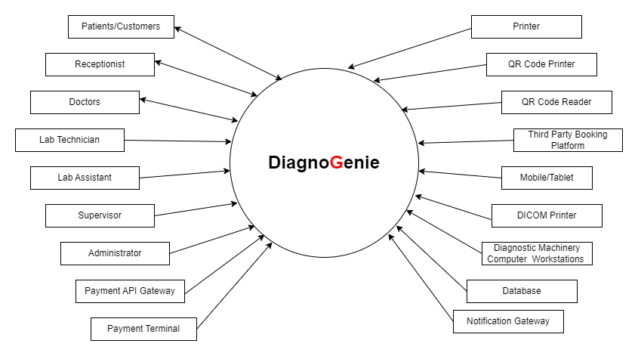
Context Diagram

Slide 9
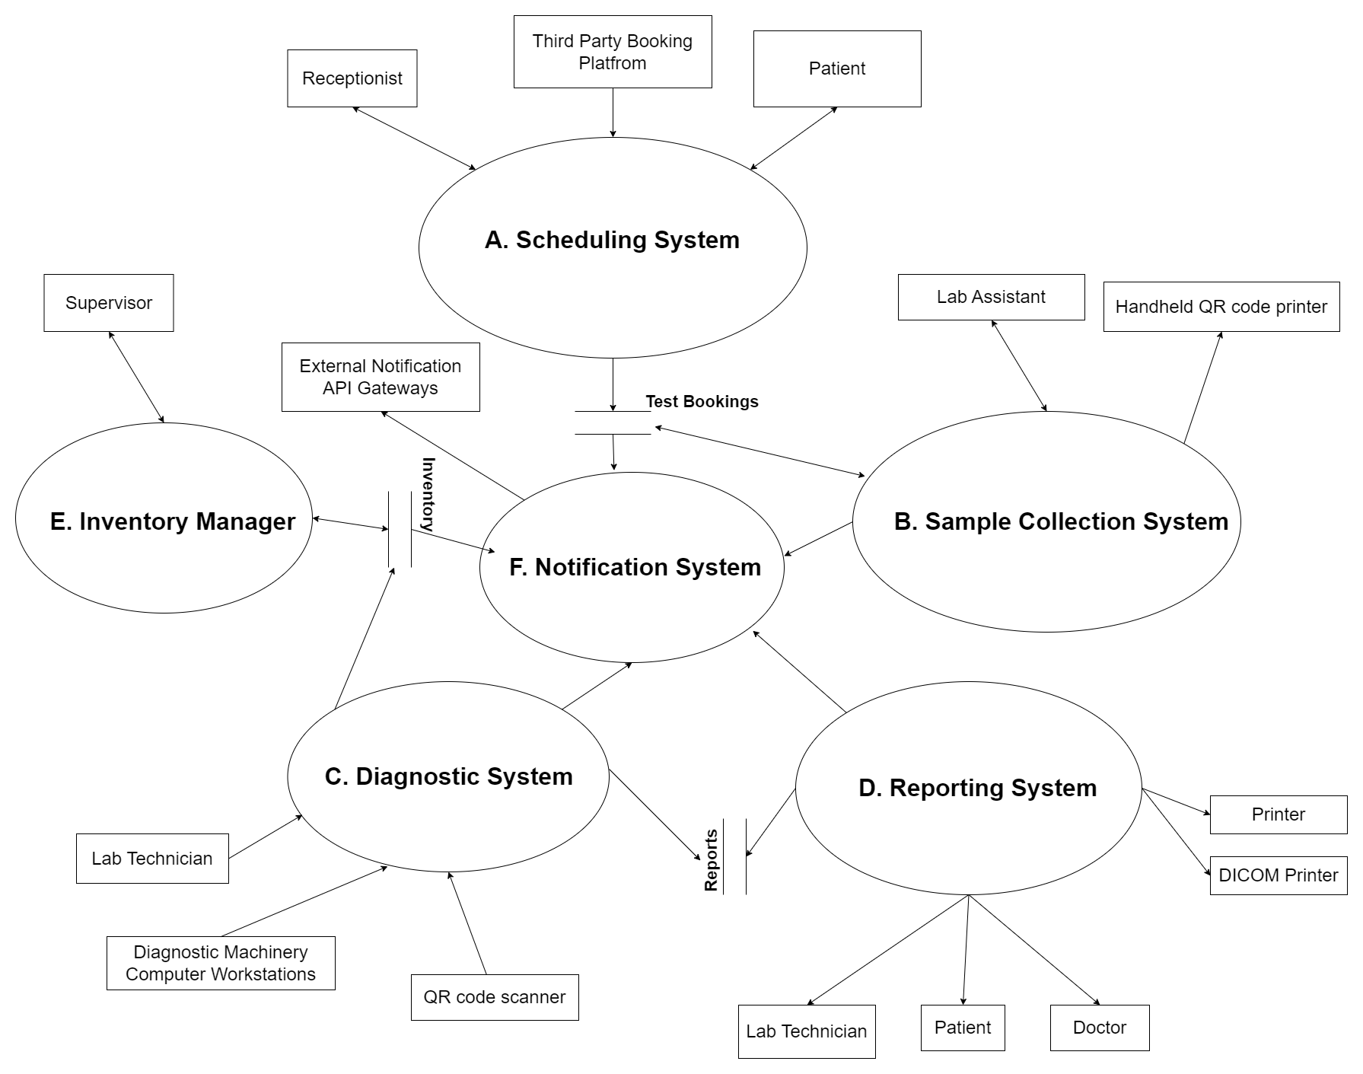
Data Flow Diagram Overview

Slide 10
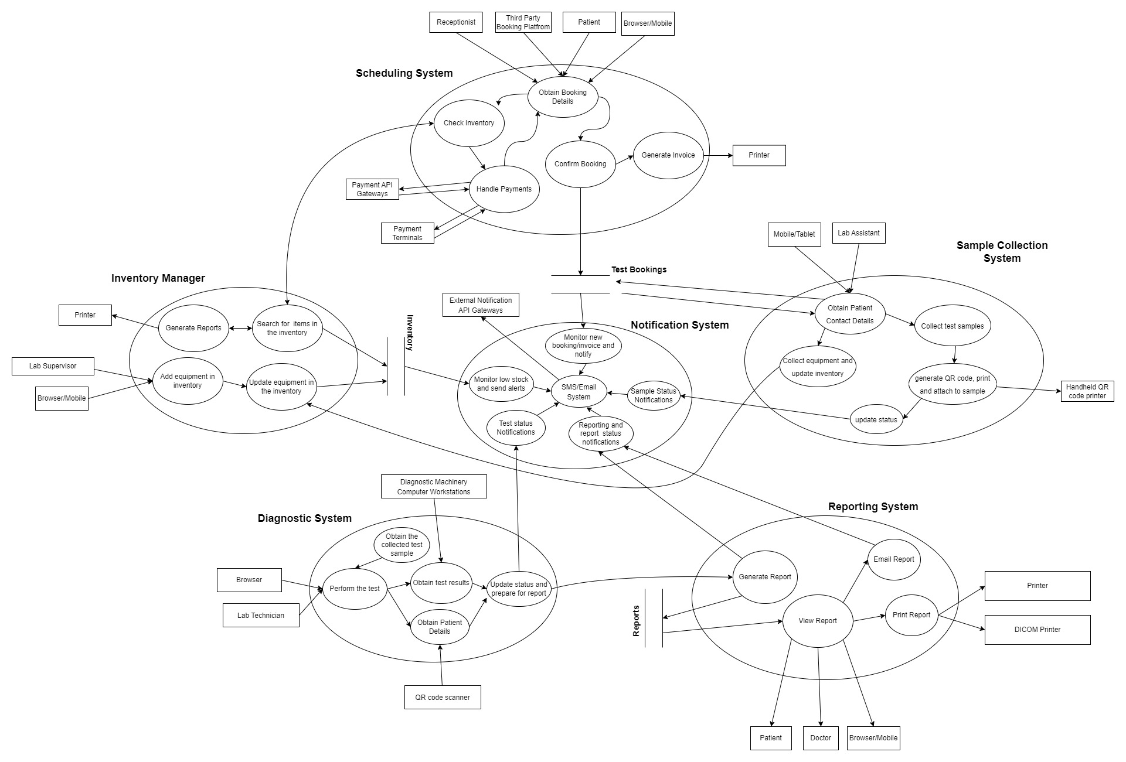
Data Flow Diagram

Slide 11
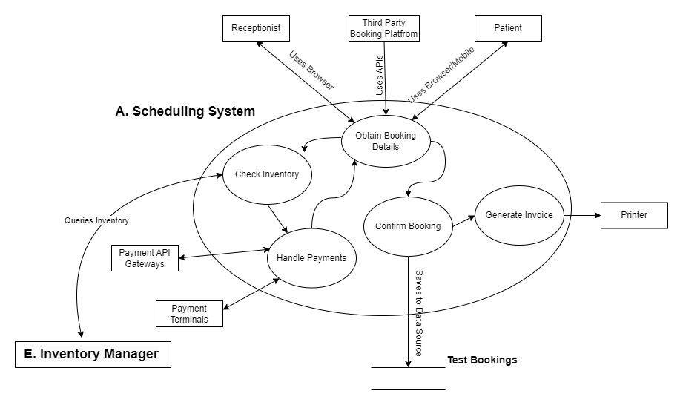
A. Scheduling System

Slide 12
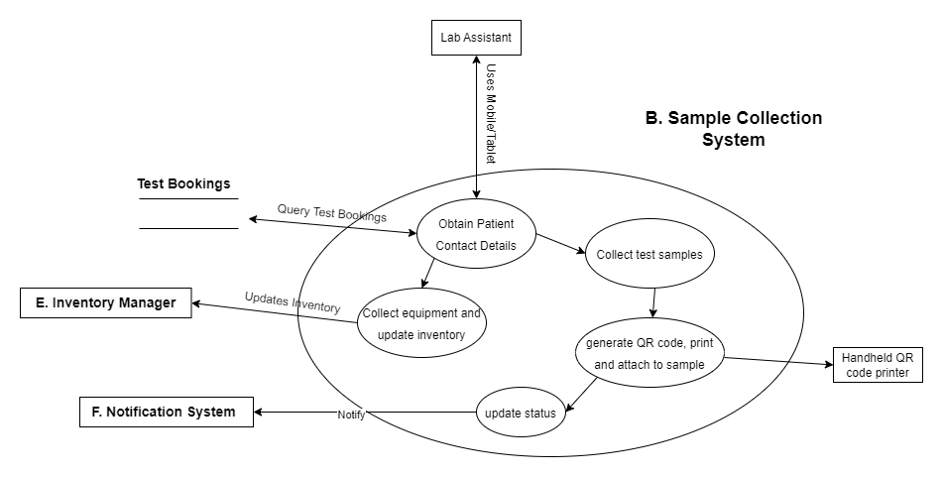
B. Sample Collection System

Slide 13
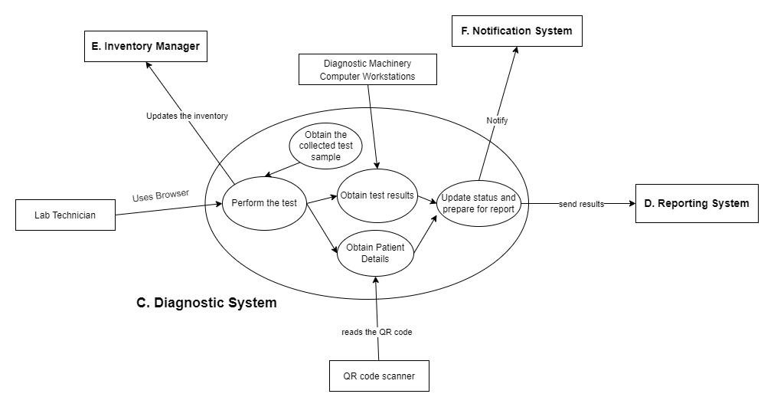
C. Diagnostic System

Slide 14
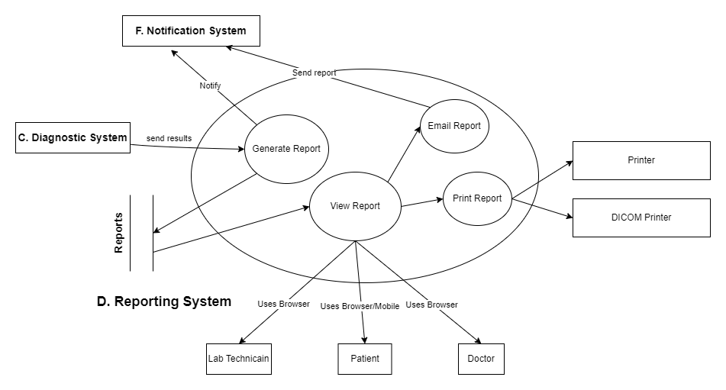
D. Reporting System

Slide 15
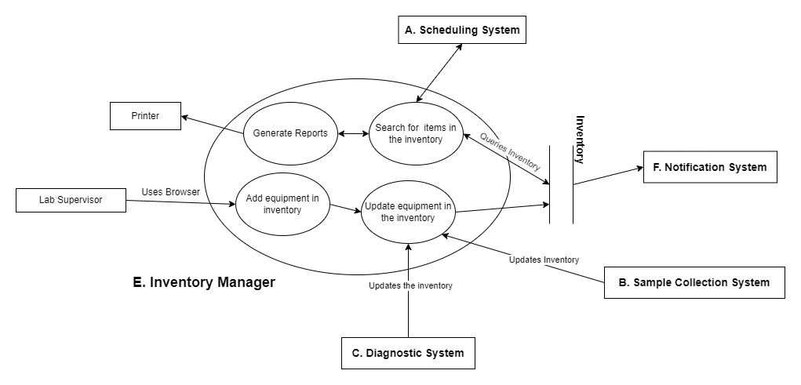
E. Inventory Manager

Slide 16
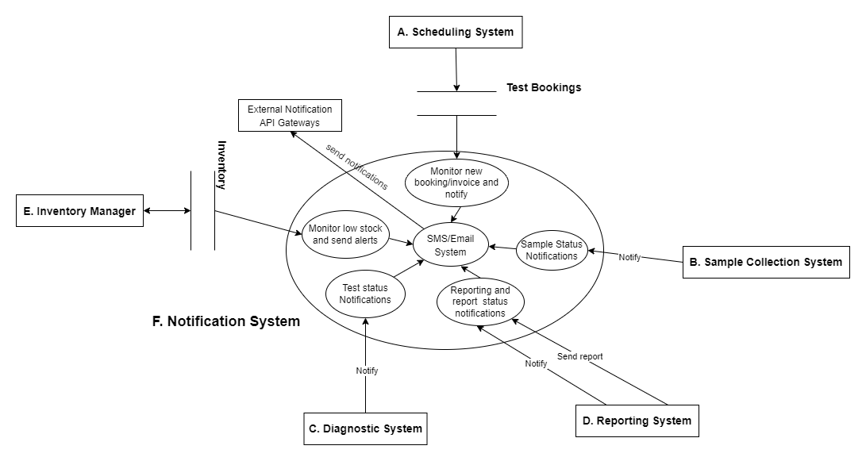
F. Notification System

Slide 17
Functional

Slide 18
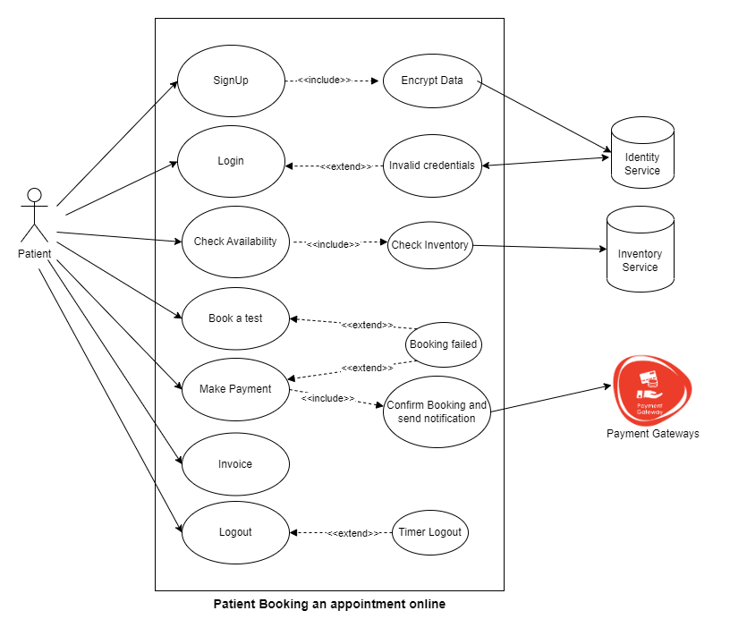
Use case for Patient Booking an appointment online

Slide 19
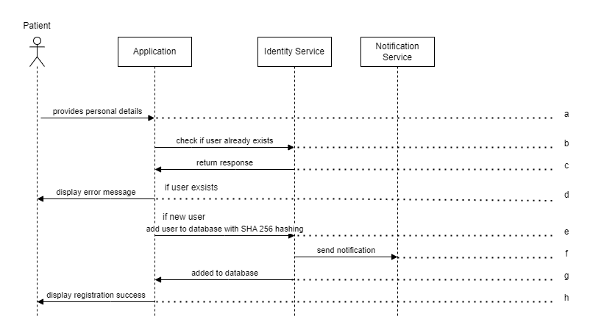
MSC for patient self registration online

Slide 20
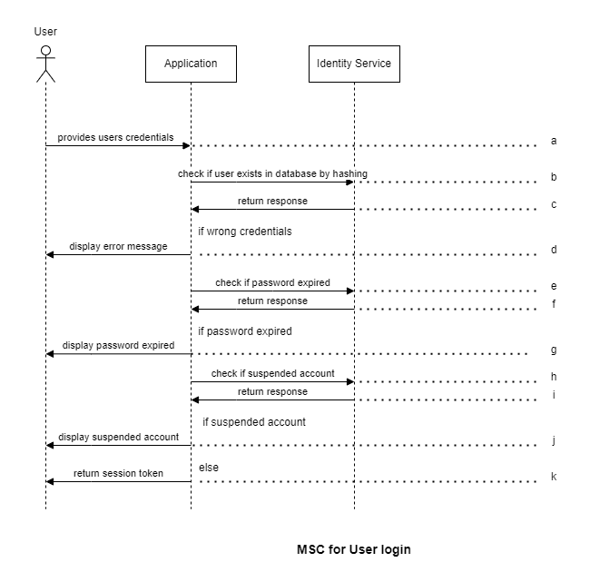
MSC for User login

Slide 21
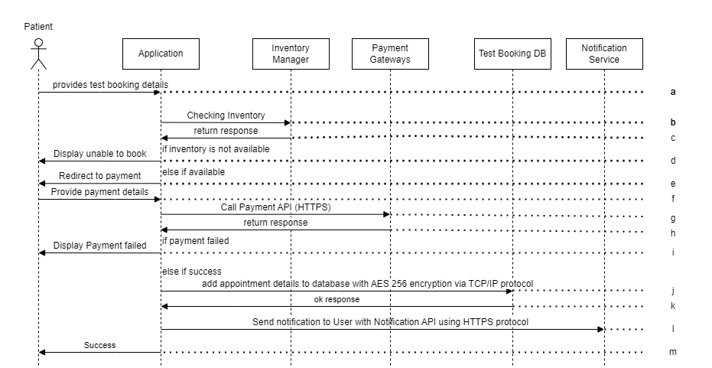
MSC for patient booking appointment online

Slide 22
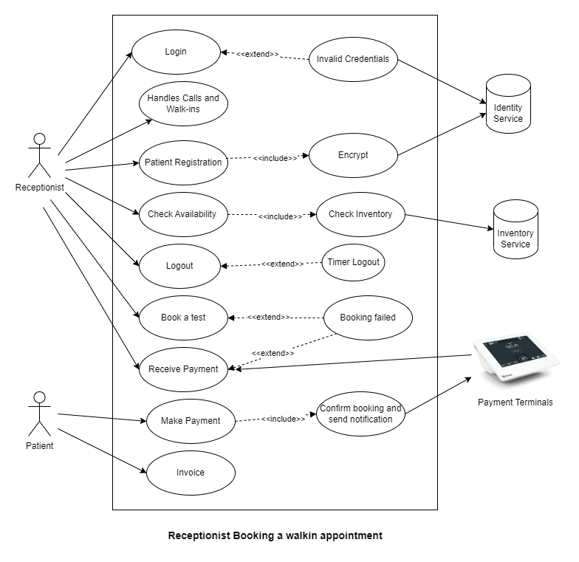
Use case for Receptionist Booking a walk-in appointment

Slide 23
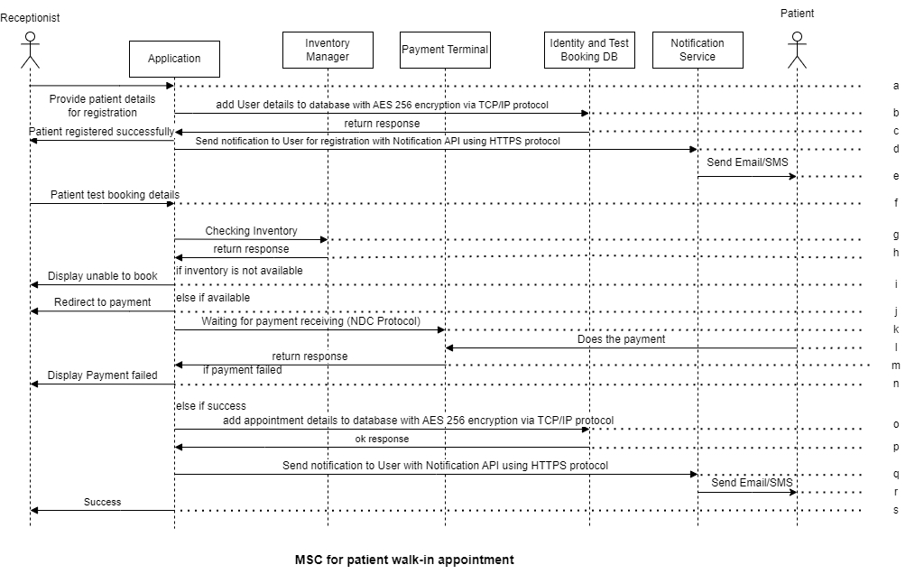
MSC for patient walk-in appointment
NDC - New Distribution Capability protocol

Slide 24
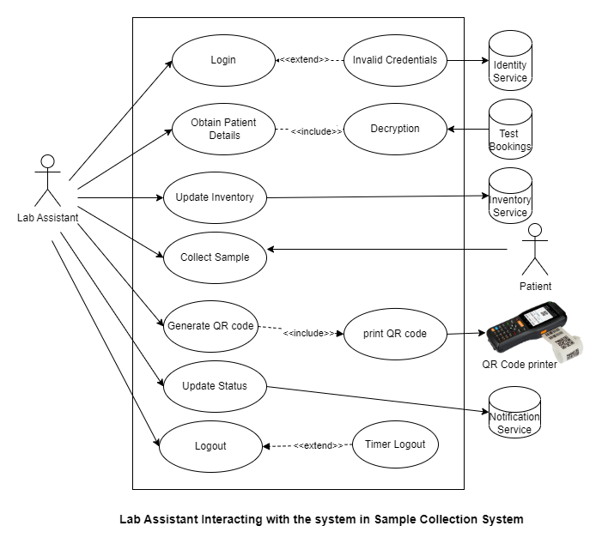
Use case for Lab Assistant Interacting with the system in Sample Collection System

Slide 25
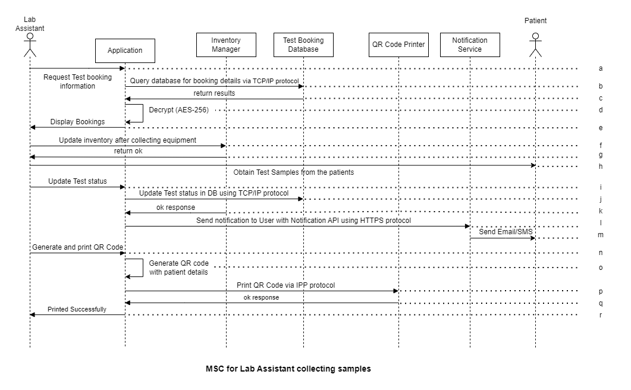
MSC for Lab Assistant collecting samples
IPP - Internet Printing Protocol

Slide 26
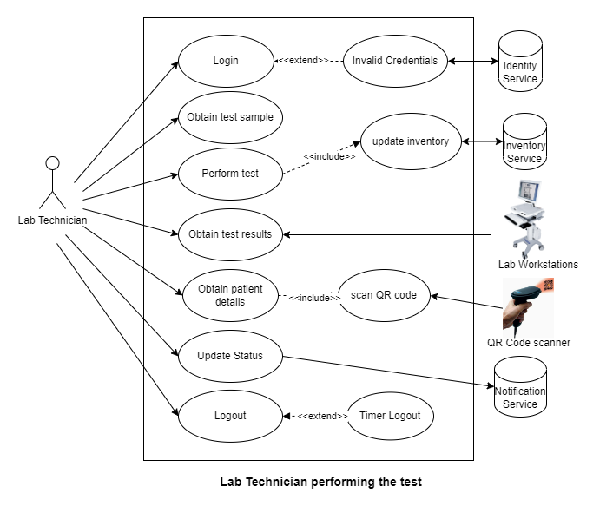
Use case for Lab Technician performing the test

Slide 27
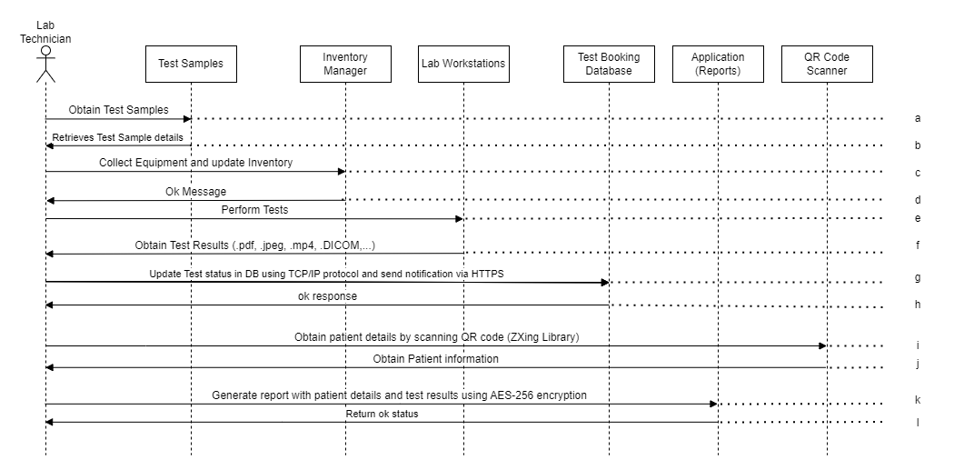
MSC for Lab Technician performing test

Slide 28
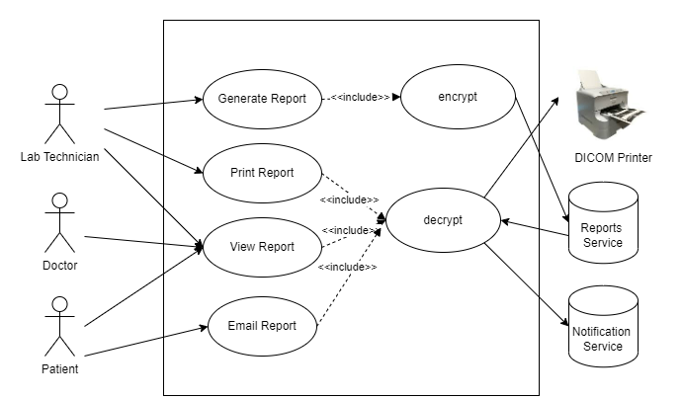
Use case for Accessing the Report

Slide 29
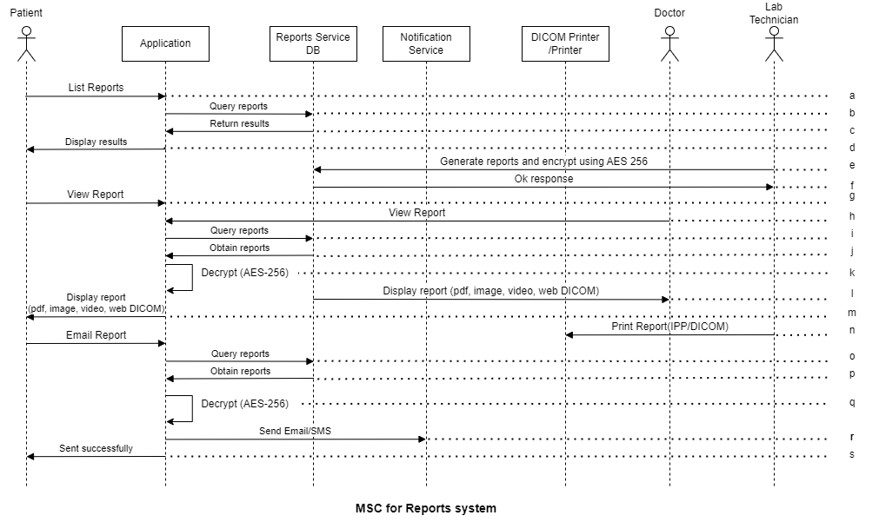
MSC for Reports system

Slide 30
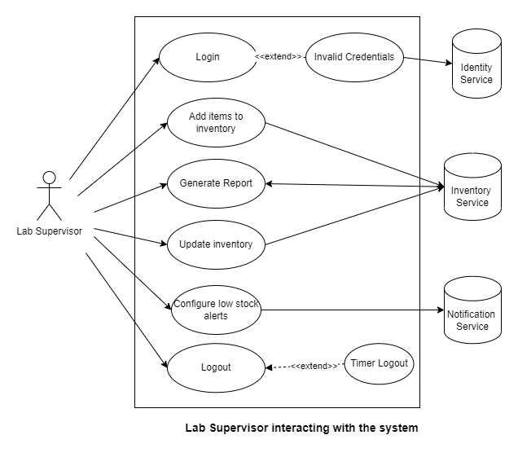
Use case for Lab Supervisor interacting with the system

Slide 31
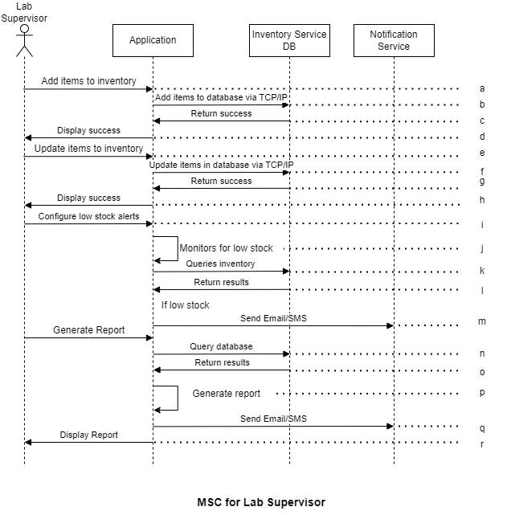
MSC for Lab Supervisor with Inventory Manager

Slide 32
OAM and Security

Slide 33
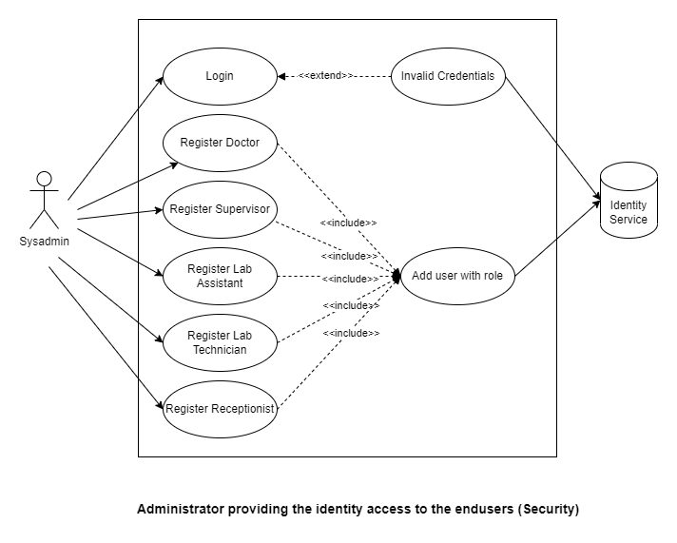
Use case - Administrator providing the identity access to the end users (Security)

Slide 34
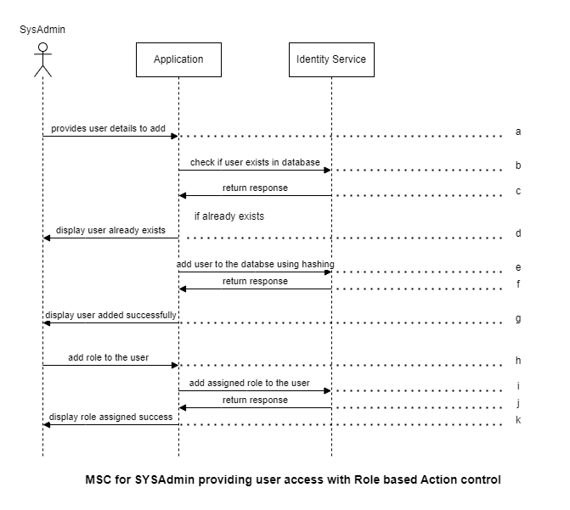
MSC for System Admin providing user access with Role based Action control

Slide 35
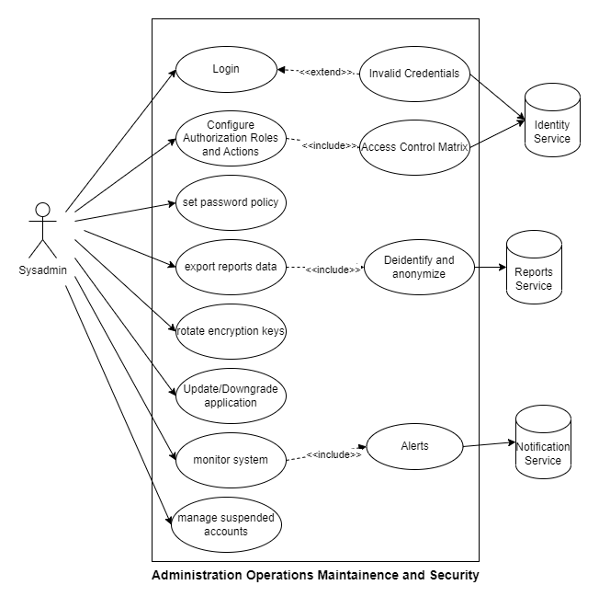
Use case for Administration Operations Maintenance and Security

Slide 36
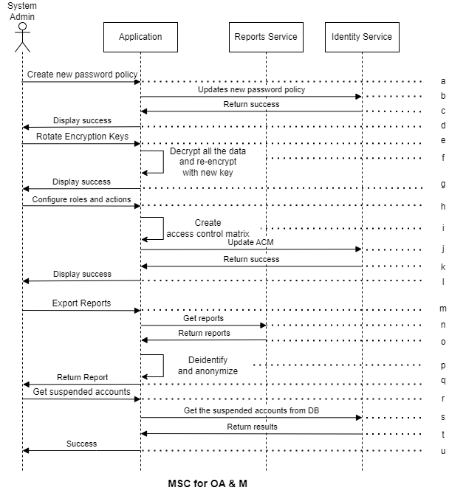
MSC for OA & M

Slide 37
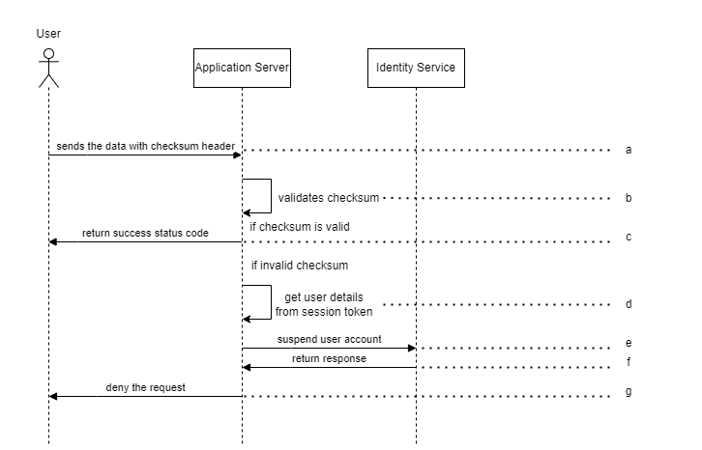
MSC for detecting attack

Slide 38
Error Recovery

Slide 39
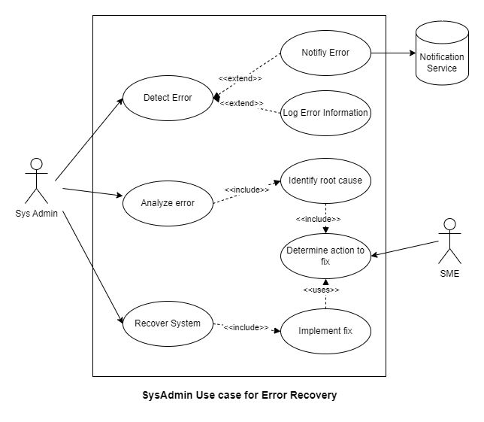
Use case for Error Recovery

Slide 40
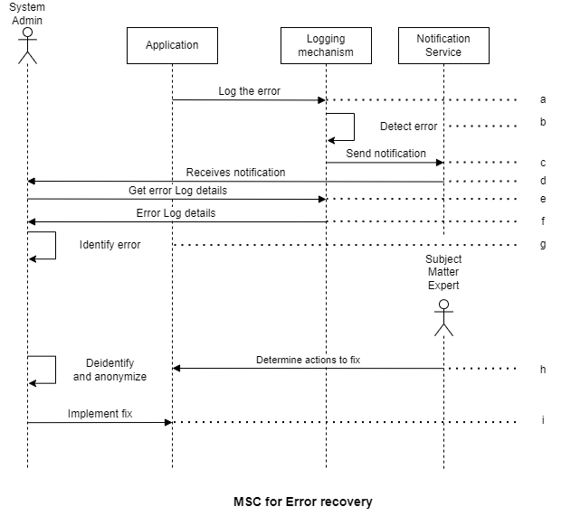
MSC for Error recovery

Slide 41
Performance

Slide 42
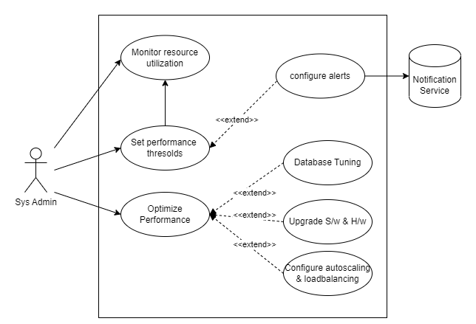
Use case for Application Performance

Slide 43
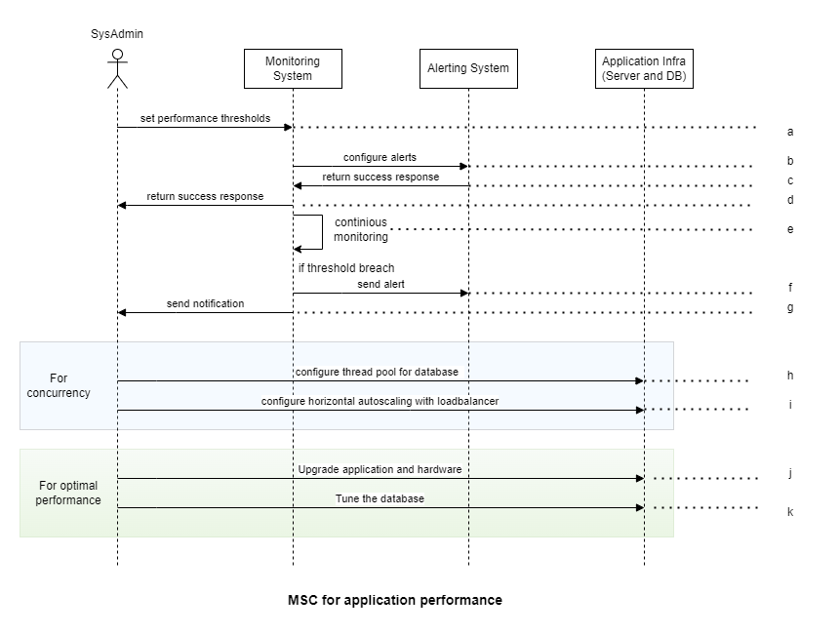
MSC for application performance

Slide 44
Availability and Reliability

Slide 45
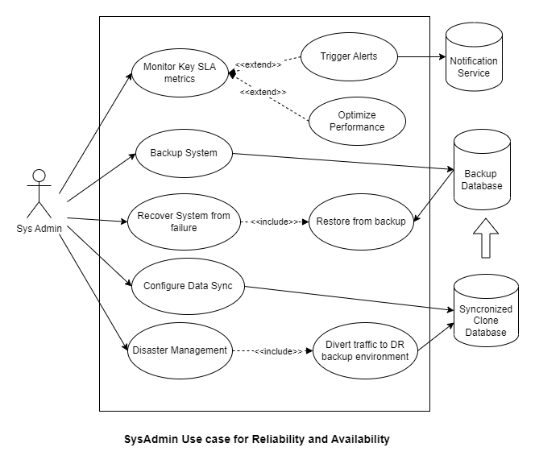
Use case for Reliability and Availability

Slide 46
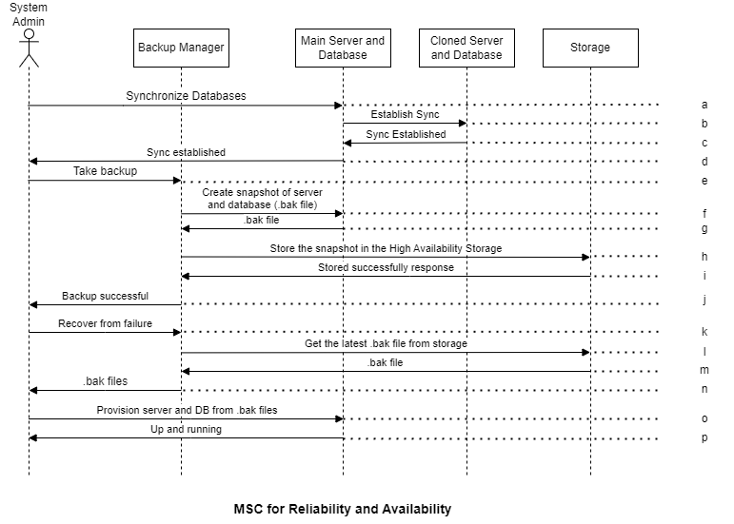
MSC for Reliability and Availability

Slide 47
Thank You

Slide 48
Appendix

Slide 49
Design Constraints – Physical Environment
Where is the equipment to be located?
The devices used for interaction with the application are located at the diagnostic laboratory, at the doctor, inventory managers, patients and sample collectors.
Is there one or several locations?
The devices are located at several locations and can be accessed from anywhere.
Are there constraints on size of the system (Handheld/Server/PC etc)?
No, there are no special constraints on size of the device used for accessing the application runs as it is deployed on cloud web server.
Are there any COTS or other constraints on programming language, OS because of existing software components?
We need to deploy the product on the cloud, so we will be using the COTS solution for cloud where the application requires the cloud-based infrastructure management tools and cloud security solutions.

Slide 50
Design Constraints – Interfaces
What are the different interfaces that the system interacts with?
Yes, the system interacts with different interfaces like payment gateways, terminals, notification gateways, printers, qr code printers and scanner, diagnostic machinery workstations.
Is input coming from one or more other systems (“upstream”)?
Yes the input should come form different systems like payment terminals, qr code scanner, diagnostic workstations.
Is output going to one or more other systems (“downstream”)?
The data is stored in the database, print requests to the printers, payment gateways, web-based image viewing APIs., notification gateways.
What is the protocol for the upstream and downstream systems?
HTTPS, TLS, API, DICOMweb, Websocket, QR Code are the different protocols used in this system.

Slide 51
Design Constraints – End Users
Who will use the system?
Different stakeholders in this system will include laboratory technicians, lab assistants, doctors, patients, administrators, and supervisors.
Will there be several types of users?
Yes, there will be several types of users and they will be having the role based access to the data and interface.
What is the skill level of each user?
Desirable All the users should have basic knowledge of operating a computer and web. The technicians should be skillful to operate the equipment and enter the correct details as per the prompt from the system.
What type of training and support will be provided for users of the system?
For the naive user, the documentation and videos for interaction and flow will be provided for different roles.

Slide 52
Quality Requirements – Performance
Are there constraints on execution speed, response time or throughput?
Essential Yes, the response time should be faster without any delays and the test life cycle have a standard time for operating.
How much data will flow through the system?
As a rough estimate, a single diagnostic lab may generate hundreds of gigabytes of data each year. For larger labs or those that perform a high volume of tests, this number could be even higher.
How often will data be received or sent?
The data will be sent and received frequently and data is handled between different systems as different stake holders are involved.
How will the system handle quality control and quality assurance processes for laboratory testing?
Using workflow management, data validation and reporting and compliance to the all the security measures and policies that are involved.

Slide 53
Quality Requirements – Usability and Human Factors
What kind of training will be required for each type of user?
Basic knowledge of understanding the application language which is English and using of the application using web and mobile interfaces.
How easy should it be for a user to understand and use the system?
It is very easy to use and operate the system even by the naïve user as now a days everyone is handling smart phone and having basic knowledge on computers usage.

Slide 54
Quality Requirements – Security
Must access to the system or information be controlled?
Yes, this application deals with patients sensitive data and all the access to the information is to be restricted. Only authorized users can access the required data and follows DISHA Act.
Should each user’s data be isolated the data of other users?
Yes, the details of one patient should not be revealed to others patients.
Should user programs be isolated from other programs and from the OS?
Yes, it should be isolated and this system should not be accessed by other programs running on the same device as it deals with sensitive data.
How will the system ensure the security and privacy of patient information?
The system uses proper encryption standards and all the security protocols while exchanging the data with external entities and compliant to DISHA Act.
How the access to the information is controlled?
The access to the information is controlled by role bases access control to the users. As per the DISHA act 32.2, data need to be stored without compromising privacy and confidentiality.
How the data is secured while transferring?
As per the DISHA Act 33.2, data while transferring should be encrypted without compromising privacy and security.
Can the data be shared for research of clinical and academics?
Yes, the data can be used for research but the data should be anonymized and deidentified before sharing.

Slide 55
Quality Requirements – Reliability and Availability
Must the system detect and isolate faults?
Yes, the system should be resilient to faults, if there is any failure or any resources running out of stock, the system should automatically detect and communicate with relevant stakeholders.
What is the prescribed Mean Time between Failures?
The system should be available 99% of the time.
Is there a maximum time allowed for restarting the system after a failure?
The downtime should not be more than 15 min during peak period and 2 hours during non peak.
How often will the system be backed up?
The system need to be backed up twice a day.
Must backup copies be stored at a different location?
Yes, if there is any problem with the current storage of data then this backup is quite helpful to restore the data.

Slide 56
Quality Requirements – Maintainability
When and in what ways might the system be changed in the future?
The system is hosted on the cloud and based of the policies and security requirements, the system will be altered.
How easy should it be to add features to the system?
The system should be adaptable and integrable for new features in the future.
How easy should it be to port (or migrate) the system from one platform to another?
It should be done easily and we are hosting on the cloud and there should be no cloud provider lock in to the application.

